Slide 1
CPSC331 - Spring 2019 Tutorial 06
Khobaib Zaamout

Slide 2
Question 1: prove n-i is bound function
Prove that n – i is a bound function for the while loop in this algorithm
integer betterFibLoop (integer n)
// Assertion: A nonnegative integer n has been given as input.
1. if (n == 0)
2. return 0
else
3. integer oldest := 0
4. integer middle := 1
5. integer i := 1
6. while (i < n) {
7. integer youngest := oldest + middle
8. oldest := middle
9. middle := youngest
10. i := i + 1
11. return middle

Slide 3
Question 1: prove n-i is bound function
Work Area:
Background: A bound function for a while loop is:
an integer-valued, total function of some of the inputs, variables and global data that are defined when the loop is reached.
When the loop body is executed, the value of this function is decreased by at least one before the loop’s test is checked again, if at all.
If the value of this function is ≤ 0 and the loop’s test is checked then the test fails (ending this execution of the loop).

Slide 4
Question 1: prove n-i is bound function
Work Area:
Background: A bound function for a while loop is:
Since n is an integer input, and i is an integer variable whose value is defined before the while loop is reached then this is certainly an integer-valued total function of the inputs and local variables of this algorithm.
an integer-valued, total function of some of the inputs, variables and global data that are defined when the loop is reached.
When the loop body is executed, the value of this function is decreased by at least one before the loop’s test is checked again, if at all.
If the value of this function is ≤ 0 and the loop’s test is checked then the test fails (ending this execution of the loop).

Slide 5
Question 1: prove n-i is bound function
Work Area:
Background: A bound function for a while loop is:
an integer-valued, total function of some of the inputs, variables and global data that are defined when the loop is reached.
When the loop body is executed, the value of this function is decreased by at least one before the loop’s test is checked again, if at all.
If the value of this function is ≤ 0 and the loop’s test is checked then the test fails (ending this execution of the loop).

Slide 6
Question 1: prove n-i is bound function
Work Area:
Background: A bound function for a while loop is:
The value of n is not changed during loop execution
The value of i is increased by one, as a result of the execution of the step at line 10.
Thus the function’s value f is decreased by (at least) one whenever the body of the while loop is executed.
an integer-valued, total function of some of the inputs, variables and global data that are defined when the loop is reached.
When the loop body is executed, the value of this function is decreased by at least one before the loop’s test is checked again, if at all.
If the value of this function is ≤ 0 and the loop’s test is checked then the test fails (ending this execution of the loop).

Slide 7
Question 1: prove n-i is bound function
Work Area:
Background: A bound function for a while loop is:
an integer-valued, total function of some of the inputs, variables and global data that are defined when the loop is reached.
When the loop body is executed, the value of this function is decreased by at least one before the loop’s test is checked again, if at all.
If the value of this function is ≤ 0 and the loop’s test is checked then the test fails (ending this execution of the loop).

Slide 8
Question 1: prove n-i is bound function
Work Area:
Background: A bound function for a while loop is:
Suppose that the value of this function is less than or equal to zero, that is, n−i ≤ 0. Then i ≥ n and the loop test at line 6 fails, causing the execution of the loop to stop.
Thus, f(n,i)=n-i is a bound function for the while loop in this algorithm, because it satisfies all the properties.
an integer-valued, total function of some of the inputs, variables and global data that are defined when the loop is reached.
When the loop body is executed, the value of this function is decreased by at least one before the loop’s test is checked again, if at all.
If the value of this function is ≤ 0 and the loop’s test is checked then the test fails (ending this execution of the loop).

Slide 9
Question 2: provide an upper bound
Use this to provide an upper bound for the number of steps executed by this algorithm on a non-negative integer n: “Uniform Cost Criterion” is being used here
integer betterFibLoop (integer n)
// Assertion: A nonnegative integer n has been given as input.
1. if (n == 0)
2. return 0
else
3. integer oldest := 0
4. integer middle := 1
5. integer i := 1
6. while (i < n) {
7. integer youngest := oldest + middle
8. oldest := middle
9. middle := youngest
10. i := i + 1
11. return middle

Slide 10
Question 2: provide an upper bound
Work Area:
Background: An upper bound function T(n) is obtained by:
Counting number of steps in “special case” inputs.
Counting number of steps using a “typical” input:
Get number of steps before loop.
Add in max number of steps possible in loop’s body:
Determine the initial value of the bound function.
For 1 ≤ i ≤ k, get the upper bound T_{body}(i) on the number of steps in the i^{th} execution of the loop’s body.
For 1 ≤ i ≤ k+1, get an upper bound T_{test}(i) on the number of steps in the i^{th} execution of the loop’s test
Work out the total number of steps.
Add in the number of other steps in the execution of the algorithm
Formulate as a function.

Slide 11
Question 2: provide an upper bound
Work Area:
Background: An upper bound function T(n) is obtained by:
When n = 0 then the steps at lines 1 and 2 are executed and the algorithm halts.
Since the “Uniform Cost Criterion” is being used here the number of steps executed is 2 in this case.
Counting number of steps in “special case” inputs.
Counting number of steps using a “typical” input:
Get number of steps before loop.
Add in max number of steps possible in loop’s body:
Determine the initial value of the bound function.
For 1 ≤ i ≤ k, get the upper bound T_{body}(i) on the number of steps in the i^{th} execution of the loop’s body.
For 1 ≤ i ≤ k+1, get an upper bound T_{test}(i) on the number of steps in the i^{th} execution of the loop’s test
Work out the total number of steps.
Add in the number of other steps in the execution of the algorithm
Formulate as a function.

Slide 12
Question 2: provide an upper bound
Work Area:
Background: An upper bound function T(n) is obtained by:
Counting number of steps in “special case” inputs.
Counting number of steps using a “typical” input:
Get number of steps before loop.
Add in max number of steps possible in loop’s body:
Determine the initial value of the bound function.
For 1 ≤ i ≤ k, get the upper bound T_{body}(i) on the number of steps in the i^{th} execution of the loop’s body.
For 1 ≤ i ≤ k+1, get an upper bound T_{test}(i) on the number of steps in the i^{th} execution of the loop’s test
Work out the total number of steps.
Add in the number of other steps in the execution of the algorithm
Formulate as a function.

Slide 13
Question 2: provide an upper bound
Work Area:
Background: An upper bound function T(n) is obtained by:
When n ≥ 1 then the test at line 1 is checked and failed, so the steps at lines 1, and 3–5 are executed before the while loop is reached
number of steps before loop = 4
Counting number of steps in “special case” inputs.
Counting number of steps using a “typical” input:
Get number of steps before loop.
Add in max number of steps possible in loop’s body:
Determine the initial value of the bound function.
For 1 ≤ i ≤ k, get the upper bound T_{body}(i) on the number of steps in the i^{th} execution of the loop’s body.
For 1 ≤ i ≤ k+1, get an upper bound T_{test}(i) on the number of steps in the i^{th} execution of the loop’s test
Work out the total number of steps.
Add in the number of other steps in the execution of the algorithm
Formulate as a function.

Slide 14
Question 2: provide an upper bound
Work Area:
Background: An upper bound function T(n) is obtained by:
Counting number of steps in “special case” inputs.
Counting number of steps using a “typical” input:
Get number of steps before loop.
Add in max number of steps possible in loop’s body:
Determine the initial value of the bound function.
For 1 ≤ i ≤ k, get the upper bound T_{body}(i) on the number of steps in the i^{th} execution of the loop’s body.
For 1 ≤ i ≤ k+1, get an upper bound T_{test}(i) on the number of steps in the i^{th} execution of the loop’s test
Work out the total number of steps.
Add in the number of other steps in the execution of the algorithm
Formulate as a function.

Slide 15
Question 2: provide an upper bound
Work Area:
Background: An upper bound function T(n) is obtained by:
The initial value for the bound function for this loop is n−1 (there are at most n−1 executions of the body of the while loop) and at most n executions of the loop test.
Counting number of steps in “special case” inputs.
Counting number of steps using a “typical” input:
Get number of steps before loop.
Add in max number of steps possible in loop’s body:
Determine the initial value of the bound function.
For 1 ≤ i ≤ k, get the upper bound T_{body}(i) on the number of steps in the i^{th} execution of the loop’s body.
For 1 ≤ i ≤ k+1, get an upper bound T_{test}(i) on the number of steps in the i^{th} execution of the loop’s test
Work out the total number of steps.
Add in the number of other steps in the execution of the algorithm
Formulate as a function.

Slide 16
Question 2: provide an upper bound
Work Area:
Background: An upper bound function T(n) is obtained by:
Counting number of steps in “special case” inputs.
Counting number of steps using a “typical” input:
Get number of steps before loop.
Add in max number of steps possible in loop’s body:
Determine the initial value of the bound function.
For 1 ≤ i ≤ k, get the upper bound T_{body}(i) on the number of steps in the i^{th} execution of the loop’s body.
For 1 ≤ i ≤ k+1, get an upper bound T_{test}(i) on the number of steps in the i^{th} execution of the loop’s test
Work out the total number of steps.
Add in the number of other steps in the execution of the algorithm
Formulate as a function.

Slide 17
Question 2: provide an upper bound
Work Area:
Background: An upper bound function T(n) is obtained by:
The loop body just consists of four statements, at lines 7–10 (4 steps).
There are no loops or tests here and no other methods are called
Then, for 1 ≤ i ≤ n − 1, the cost of the i^{th} execution of the loop body is:
T_{body}(i) = 4
Counting number of steps in “special case” inputs.
Counting number of steps using a “typical” input:
Get number of steps before loop.
Add in max number of steps possible in loop’s body:
Determine the initial value of the bound function.
For 1 ≤ i ≤ k, get the upper bound T_{body}(i) on the number of steps in the i^{th} execution of the loop’s body.
For 1 ≤ i ≤ k+1, get an upper bound T_{test}(i) on the number of steps in the i^{th} execution of the loop’s test
Work out the total number of steps.
Add in the number of other steps in the execution of the algorithm
Formulate as a function.

Slide 18
Question 2: provide an upper bound
Work Area:
Background: An upper bound function T(n) is obtained by:
Counting number of steps in “special case” inputs.
Counting number of steps using a “typical” input:
Get number of steps before loop.
Add in max number of steps possible in loop’s body:
Determine the initial value of the bound function.
For 1 ≤ i ≤ k, get the upper bound T_{body}(i) on the number of steps in the i^{th} execution of the loop’s body.
For 1 ≤ i ≤ k+1, get an upper bound T_{test}(i) on the number of steps in the i^{th} execution of the loop’s test
Work out the total number of steps.
Add in the number of other steps in the execution of the algorithm
Formulate as a function.

Slide 19
Question 2: provide an upper bound
Work Area:
Background: An upper bound function T(n) is obtained by:
The loop test consists of a single statement which does not call any other methods
So, for 1 ≤ i ≤ n, the cost of the ith execution of the loop test is:
T_{test}(i) = 1
Counting number of steps in “special case” inputs.
Counting number of steps using a “typical” input:
Get number of steps before loop.
Add in max number of steps possible in loop’s body:
Determine the initial value of the bound function.
For 1 ≤ i ≤ k, get the upper bound T_{body}(i) on the number of steps in the i^{th} execution of the loop’s body.
For 1 ≤ i ≤ k+1, get an upper bound T_{test}(i) on the number of steps in the i^{th} execution of the loop’s test
Work out the total number of steps.
Add in the number of other steps in the execution of the algorithm
Formulate as a function.

Slide 20
Question 2: provide an upper bound
Work Area:
Background: An upper bound function T(n) is obtained by:
Counting number of steps in “special case” inputs.
Counting number of steps using a “typical” input:
Get number of steps before loop.
Add in max number of steps possible in loop’s body:
Determine the initial value of the bound function.
For 1 ≤ i ≤ k, get the upper bound T_{body}(i) on the number of steps in the i^{th} execution of the loop’s body.
For 1 ≤ i ≤ k+1, get an upper bound T_{test}(i) on the number of steps in the i^{th} execution of the loop’s test
Work out the total number of steps.
Add in the number of other steps in the execution of the algorithm
Formulate as a function.

Slide 21
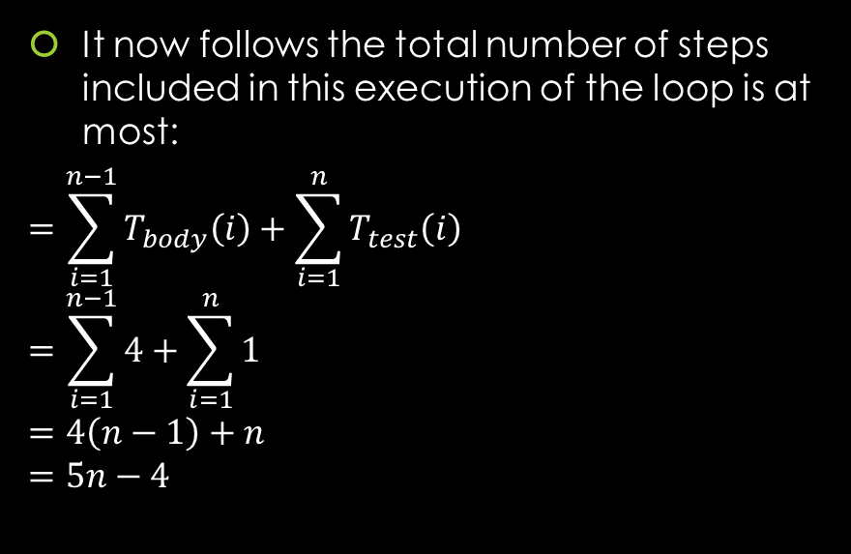
Question 2: provide an upper bound
Work Area:
Background: An upper bound function T(n) is obtained by:
It now follows the total number of steps included in this execution of the loop is at most:
$$=\sum_{i=1}^{n−1}{T_{body}\left(i\right)}+\sum_{i=1}^{n}{T_{test}\left(i\right)} \\ =\sum_{i=1}^{n−1}{4}+\sum_{i=1}^{n}{1} \\ =4\left(n−1\right)+n \\ =5n−4$$
Counting number of steps in “special case” inputs.
Counting number of steps using a “typical” input:
Get number of steps before loop.
Add in max number of steps possible in loop’s body:
Determine the initial value of the bound function.
For 1 ≤ i ≤ k, get the upper bound T_{body}(i) on the number of steps in the i^{th} execution of the loop’s body.
For 1 ≤ i ≤ k+1, get an upper bound T_{test}(i) on the number of steps in the i^{th} execution of the loop’s test
Work out the total number of steps.
Add in the number of other steps in the execution of the algorithm
Formulate as a function.

Slide 22

Question 2: provide an upper bound
Work Area:
Background: An upper bound function T(n) is obtained by:
From previous step: number of steps before loop = 4.
So,
$$=4+5n−4 \\ =5n$$
Counting number of steps in “special case” inputs.
Counting number of steps using a “typical” input:
Get number of steps before loop.
Add in max number of steps possible in loop’s body:
Determine the initial value of the bound function.
For 1 ≤ i ≤ k, get the upper bound T_{body}(i) on the number of steps in the i^{th} execution of the loop’s body.
For 1 ≤ i ≤ k+1, get an upper bound T_{test}(i) on the number of steps in the i^{th} execution of the loop’s test
Work out the total number of steps.
Add in the number of other steps in the execution of the algorithm
Formulate as a function.

Slide 23
Question 2: provide an upper bound
Work Area:
Background: An upper bound function T(n) is obtained by:
Counting number of steps in “special case” inputs.
Counting number of steps using a “typical” input:
Get number of steps before loop.
Add in max number of steps possible in loop’s body:
Determine the initial value of the bound function.
For 1 ≤ i ≤ k, get the upper bound T_{body}(i) on the number of steps in the i^{th} execution of the loop’s body.
For 1 ≤ i ≤ k+1, get an upper bound T_{test}(i) on the number of steps in the i^{th} execution of the loop’s test
Work out the total number of steps.
Add in the number of other steps in the execution of the algorithm
Formulate as a function.

Slide 24
Question 2: provide an upper bound
Work Area:
Background: An upper bound function T(n) is obtained by:
There is one more statement at line 11 that is executed after this loop.
So, number of steps after the loop = 1
Counting number of steps in “special case” inputs.
Counting number of steps using a “typical” input:
Get number of steps before loop.
Add in max number of steps possible in loop’s body:
Determine the initial value of the bound function.
For 1 ≤ i ≤ k, get the upper bound T_{body}(i) on the number of steps in the i^{th} execution of the loop’s body.
For 1 ≤ i ≤ k+1, get an upper bound T_{test}(i) on the number of steps in the i^{th} execution of the loop’s test
Work out the total number of steps.
Add in the number of other steps in the execution of the algorithm
Formulate as a function.

Slide 25
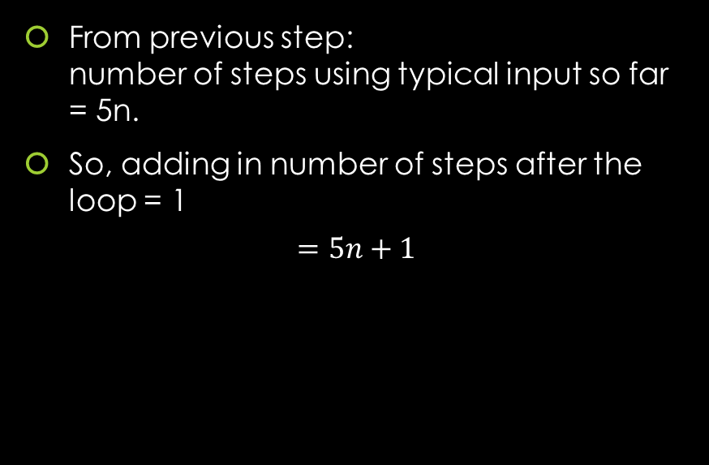
Question 2: provide an upper bound
Work Area:
Background: An upper bound function T(n) is obtained by:
From previous step: number of steps using typical input so far = 5n.
So, adding in number of steps after the loop = 1
$$=5n+1$$
Counting number of steps in “special case” inputs.
Counting number of steps using a “typical” input:
Get number of steps before loop.
Add in max number of steps possible in loop’s body:
Determine the initial value of the bound function.
For 1 ≤ i ≤ k, get the upper bound T_{body}(i) on the number of steps in the i^{th} execution of the loop’s body.
For 1 ≤ i ≤ k+1, get an upper bound T_{test}(i) on the number of steps in the i^{th} execution of the loop’s test
Work out the total number of steps.
Add in the number of other steps in the execution of the algorithm
Formulate as a function.

Slide 26
Question 2: provide an upper bound
Work Area:
Background: An upper bound function T(n) is obtained by:
Counting number of steps in “special case” inputs.
Counting number of steps using a “typical” input:
Get number of steps before loop.
Add in max number of steps possible in loop’s body:
Determine the initial value of the bound function.
For 1 ≤ i ≤ k, get the upper bound T_{body}(i) on the number of steps in the i^{th} execution of the loop’s body.
For 1 ≤ i ≤ k+1, get an upper bound T_{test}(i) on the number of steps in the i^{th} execution of the loop’s test
Work out the total number of steps.
Add in the number of other steps in the execution of the algorithm
Formulate as a function.

Slide 27

Question 2: provide an upper bound
Work Area:
Background: An upper bound function T(n) is obtained by:
$$T\left(n\right)=\left\{\begin{aligned}2, if n=0, \\ &5n+1, if n≥1.\end{aligned}\right.$$
Counting number of steps in “special case” inputs.
Counting number of steps using a “typical” input:
Get number of steps before loop.
Add in max number of steps possible in loop’s body:
Determine the initial value of the bound function.
For 1 ≤ i ≤ k, get the upper bound T_{body}(i) on the number of steps in the i^{th} execution of the loop’s body.
For 1 ≤ i ≤ k+1, get an upper bound T_{test}(i) on the number of steps in the i^{th} execution of the loop’s test
Work out the total number of steps.
Add in the number of other steps in the execution of the algorithm
Formulate as a function.

Slide 28
Question 3: write a recurrence
Write a recurrence for the number T(n) of numbered steps executed by this algorithm on a non-negative integer input n. (the “Uniform Cost Criterion” is being used to estimate a running time.)
Note: If you have answered this question correctly then you should be able to use your answer to confirm that T(0) = 5, T(1) = 11, T(2) = 17, and T(3) = 23.
integer[] fibPair (integer n) {
// Assertion: A nonnegative integer n is the input
1. integer[] F = new integer[2]
2. if (n == 0)
3. F[0] := 0
4. F[1] := 1
else
5. integer[] oldF := fibPair(n − 1)
6. F[0] := oldF[1]
7. F[1] := oldF[0] + oldF[1]
8. return F

Slide 29
Question 3: write a recurrence
Work Area:
Background: An upper bound function T(n) is obtained by:
Counting number of steps in “special case” inputs.
Counting number of steps using a “typical” input.
Formulate as a function.

Slide 30
Question 3: write a recurrence
Work Area:
Background: An upper bound function T(n) is obtained by:
When n = 0 then 5 numbered steps are executed namely, the steps at lines 1, 2, 3, 4, and 8.
Number of steps in “special case” input = 5
Counting number of steps in “special case” inputs.
Counting number of steps using a “typical” input.
Formulate as a function.

Slide 31
Question 3: write a recurrence
Work Area:
Background: An upper bound function T(n) is obtained by:
Counting number of steps in “special case” inputs.
Counting number of steps using a “typical” input.
Formulate as a function.

Slide 32
Question 3: write a recurrence
Work Area:
Background: An upper bound function T(n) is obtained by:
When n ≥ 1 then 6 numbered steps are executed: these at lines 1, 2, 5, 6, 7 and 8
Number of steps using “typical” input = 6
Counting number of steps in “special case” inputs.
Counting number of steps using a “typical” input.
Formulate as a function.

Slide 33
Question 3: write a recurrence
Work Area:
Background: An upper bound function T(n) is obtained by:
Counting number of steps in “special case” inputs.
Counting number of steps using a “typical” input.
Formulate as a function.

Slide 34
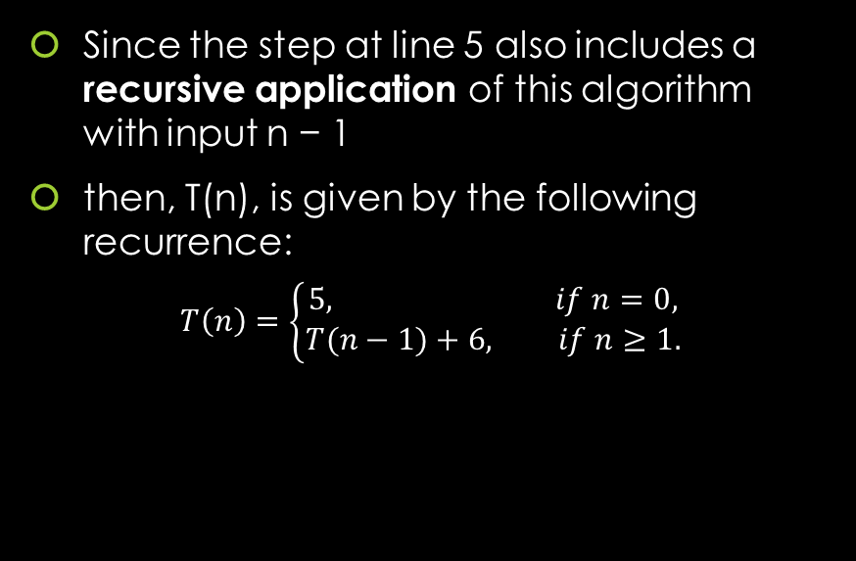
Question 3: write a recurrence
Work Area:
Background: An upper bound function T(n) is obtained by:
Since the step at line 5 also includes a recursive application of this algorithm with input n − 1
then, T(n), is given by the following recurrence:
$$T\left(n\right)=\left\{\begin{aligned}5, if n=0, \\ &T(n−1)+6, if n≥1.\end{aligned}\right.$$
Counting number of steps in “special case” inputs.
Counting number of steps using a “typical” input.
Formulate as a function.

Slide 35
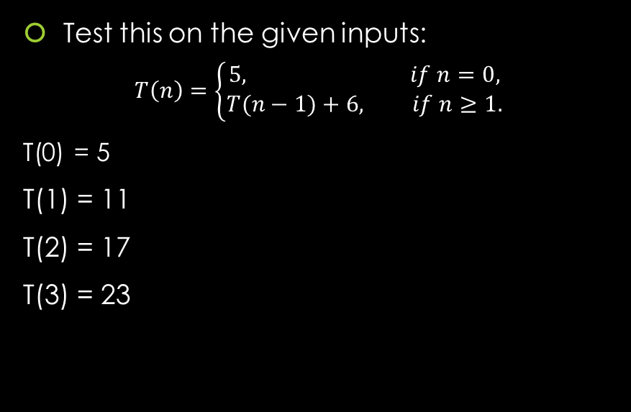
Question 3: write a recurrence
Work Area:
Background: An upper bound function T(n) is obtained by:
Test this on the given inputs:
$$T\left(n\right)=\left\{\begin{aligned}5, if n=0, \\ &T(n−1)+6, if n≥1.\end{aligned}\right.$$
T(0) = 5
T(1) = 11
T(2) = 17
T(3) = 23
Counting number of steps in “special case” inputs.
Counting number of steps using a “typical” input.
Formulate as a function.

Slide 36
Question 4: Guess solution for recurrence
Guess a simple solution for this recurrence
integer[] fibPair (integer n) {
// Assertion: A nonnegative integer n is the input
1. integer[] F = new integer[2]
2. if (n == 0)
3. F[0] := 0
4. F[1] := 1
else
5. integer[] oldF := fibPair(n − 1)
6. F[0] := oldF[1]
7. F[1] := oldF[0] + oldF[1]
8. return F

Slide 37

Question 4: Guess solution for recurrence
Work Area:
Background: An upper bound function T(n) is obtained by:
Search for pattern by applying multiple inputs:
$$T\left(n\right)=\left\{\begin{aligned}5, if n=0, \\ &T(n−1)+6, if n≥1.\end{aligned}\right.$$

Slide 38
Question 4: Guess solution for recurrence
Work Area:
Background: An upper bound function T(n) is obtained by:
T(0) = 5
T(1) = T(0) + 6
= 5 + 6 = 11
T(2) = T(1) + 6
= T(0) + 6 + 6 = 5 + 6 + 6 = 17
…
Search for pattern by applying multiple inputs:
$$T\left(n\right)=\left\{\begin{aligned}5, if n=0, \\ &T(n−1)+6, if n≥1.\end{aligned}\right.$$

Slide 39

Question 4: Guess solution for recurrence
Work Area:
Background: An upper bound function T(n) is obtained by:
T(0) = 5
T(1) = T(0) + 6
= 5 + 6 = 11
T(2) = T(1) + 6
= T(0) + 6 + 6 = 5 + 6 + 6 = 17
… 6 repeats n times and 5 is constant
T(n) = 6n + 5
Search for pattern by applying multiple inputs:
$$T\left(n\right)=\left\{\begin{aligned}5, if n=0, \\ &T(n−1)+6, if n≥1.\end{aligned}\right.$$

